Slide 1
Selenide Review
And How To Start Using It In Legacy Selenium Tests

Slide 2


What is Selenide?

Slide 3
Make tests more readable
$$(summaryResults).shouldHave(sizeGreaterThan(0)) .filter(Condition.visible).first().getText();
SelenideElement table = $(byText("First name")).closest(".v-table");
table.findAll(".v-table-header .v-table-header-cell")
.shouldHave(texts("First name", "Last name", "Email", "Phone number"
, "Street Address", "Postal Code", "City"));

Slide 4
Simple selectors
Selenide
$(WebElement)
$(By)
$(String)
Selenium
Webelement WebDriver.findElement(By) WebDriver.findElement(By.cssSelector(String))

Slide 5
.$x(xpath)
Selenide can do
$("table").$x(".//tr")
$("table").$$x(".//tr")
When Selenium needs
WebDriver.findElement(By.cssSelector("table")).findElement(By.xpath(".//tr"));
WebDriver.findElement(By.cssSelector("table")).findElements(By.xpath(".//tr"));

Slide 6
Other selectors
$(byText("Logout")); // search by exact text $(withText("Logout")); // search by text (substring) $(byTitle("Logout")); // search by "title" attribute $(byAttribute("class", "g")); // search by attribute $(byValue("example")); // search by "value" attribute

Slide 7
Scoping selectors
$("#mainElement").$("#subElement"); $("#customerContainer").find(".user_name"); $("li", 5); // looking for Nth element $$("li").get(5);

Slide 8
Clicking actions
$("#submit").click(); $("#agreement").submit(); $(".g").doubleClick(); $(".g").contextClick(); $("q").pressEnter(); $("q").pressTab();

Slide 9
Form actions
$("#login").setValue("John Doe"); $("#login").val("John Doe"); // same as .setValue() $(".menu").selectOption(String text); $(By.name("menu")).selectOptionByValue(String value); $(By.name("menu")).getSelectedOption(); $(By.name("menu")).getSelectedText(); $(By.name("menu")).getSelectedValue(); selectRadio(By.name("user.gender"), "male"); $("#element")).hover();

Slide 10
Text Assertions && deal with Ajax
$("#element").shouldHave(text("abc")); $("h1").shouldHave(exactText("Hello")) $("h1").shouldHave(textCaseSensitive("Hello\s*John")); $("h1").shouldHave(exactTextCaseSensitive("Hello")); $("#input").shouldHave(exactValue("John"));
$("#input").shouldNotHave(text("Hello"), text("World"));

Slide 11
Attribute Assertions && deal with Ajax
$("h1").shouldHave(css("font-size", "16px")); $("#input").shouldHave(name("fname")); $("#input").shouldHave(type("checkbox")); $("#input").shouldHave(id("myForm")); $("#input").shouldHave(attribute("id"[, "myForm"]));

Slide 12
My Favorite Assertions && deal with Ajax
$("input").shouldBe(visible, enabled); //visible | appear
$("input").shouldNotBe(visible, enabled);
$("input").shouldBe(not(visible, enabled)); $("input").shouldBe(exist); //present | exist $("input").shouldBe(hidden); //hidden | disappear | not(visible) $("input").shouldBe(readonly); $("input").shouldBe(focused); $(".errors").shouldBe(empty); $("#element").should(exist);

Slide 13
Collections Assertions && deal with Ajax
$$(".errors").shouldHave(size(2)); $$("gs-title").shouldHave(sizeGreaterThan(5)); $$(".errors").shouldBe(empty); $$(".errors").shouldHave(exactTexts("text 1", "text 2")); $$(".errors").shouldHave(texts("text 1", "text 2"));

Slide 14
Configuration
Configuration.timeout Configuration.collectionsTimeout Configuration.pollingInterval Configuration.collectionsPollingInterval Configuration.pageLoadStrategy // (none | normal | eager) Configuration.startMaximized ...

Slide 15
should... vs. waitUntil
should(...) == shouldBe(...) == shouldHave(...) → Synonyms
shouldNot(...) == shouldNotBe(...) == shouldNotHave(...) → Synonyms
Their timeout is set by Selenide configuration. For specific timeout:
$("#username").waitUntil(matchesText("Johny"), 2000); $("#username").waitUntil(not(matchesText("Noname")), 2000); $("#username").waitUntil(visible, 5000);

Slide 16
Add Selenium to project:
Open Selenide Quick Starts and use hints
For Legacy project use:
WebDriverRunner.setWebDriver(yourDriver);
Wrap WebElement in $(...) → $(legacyElement)
Start using full power of Selenide

Slide 17
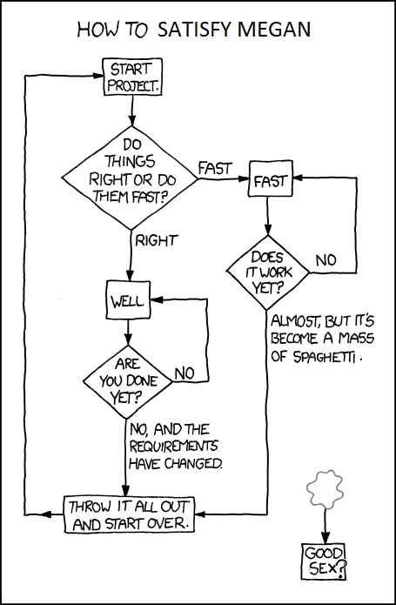
Do you need Selenide ?
Search “good code vs bad code” for this img.

Slide 18
Demo

Slide 19

Questions?
Usefull links:
This demo:
https://github.com/alex-d-bondarev/selenide-demo
Selenide Quick Start:
http://selenide.org/quick-start.html
Selenide Cheat Sheet
https://gist.github.com/mkpythonanywhereblog/947633ba1bf0bc239639

Slide 20

Thanks!
Contact me:
Oleksandr Bondarev
alex.d.bondarev@gmail.com

